Slide 1
Active Feature Acquisition on Data Streams Tutorial @ IE2025
Dr.-Ing. Christian Beyer | 24.06.2025
christian.beyer@ovgu.de
Notes:
Multi-Task Learning → partly true, →do not share structure unless ensemble → different training data but same task
Recommenders rely user-user or item-item similarities. -> ignored
Recommenders often aggregate data across entities. ->not yet.
Recommenders seek cross-entity generalization (e.g., new users/items).
Entity-centric learning focuses on intra-entity generalization, avoiding global patterns.

Slide 2
Content
Background on Active Feature Acquisition (20min)
Introduction to the Framework (10min)
Coding Exercises 1 (30min)
Coffee Break (30min)
Coding Exercises 2 (10-20min)
Presentation of Solutions and Discussion (20min)

Slide 3

Problems when Features are Missing
Missing features are common (patients, sensors, questionnaires…)
Most classifiers need feature complete instances to do predictions
Prediction quality suffers if important features are missing → Guess missing features (imputation) → Acquire features for a cost (AFA)
Notes:
Maybe explain active learning briefly

Slide 4

Cost-aware active feature acquisition (AFA)
Which sensor
should I fix next?
Consider scenarios where missing feature values can be acquired for a cost
The missing data is simulated to be missing completely at random
Subfield of active learning
[https://www.vaisala.com/en/blog/2024-01/common-humidity-measurement-problems-and-how-avoid-them]
Notes:
Add missingness overview slide to backup

Slide 5
Cost-aware active feature acquisition (AFA)
Which sensor
should I fix next?
Consider scenarios where missing feature values can be acquired for a cost
The missing data is simulated to be missing completely at random
Subfield of active learning
[https://www.vaisala.com/en/blog/2024-01/common-humidity-measurement-problems-and-how-avoid-them]
Notes:
Add missingness overview slide to backup

Slide 6
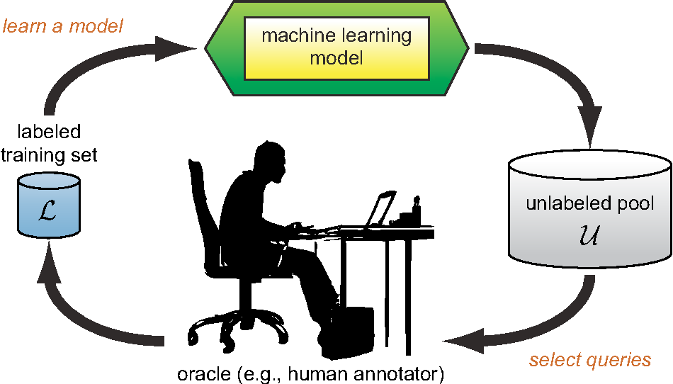
Cost-aware active feature acquisition (AFA)
Consider scenarios where missing feature values can be acquired for a cost
The missing data is simulated to be missing completely at random
Subfield of active learning
[https://www.semanticscholar.org/paper/Active-Learning-Literature-Survey-Settles/818826f356444f3daa3447755bf63f171f39ec47/figure/0]
Notes:
Budgeting in static case is trivial (number of instances are all money spend)

Slide 7
Static cost-aware active feature acquisition (AFA)
Complex feature interactions can be learned from available data (e.g. decision tree)
Costly optimization algorithms can be employed to manage budgeting …but what can we do when the data is streaming?
Notes:
Budgeting in static case is trivial (number of instances are all money spend)

Slide 8

What is a data stream?
‘A data stream is an ordered sequence of instances that can be read only once or a small number of times using limited computing and storage capabilities. These sources of data are characterized by being open-ended, flowing at high-speed, and generated by non stationary distributions in dynamic environments.’ Gama & Rodrigues
[https://www.bigdatawire.com/2019/10/01/kafka-transforming-into-event-streaming-database/]

Slide 9
What makes learning on data streams challenging?
High volume
High velocity
High variety
Incremental models
Forgetting mechanisms

Slide 10
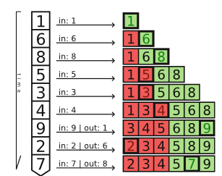
Budgeting with the Incremental Percentile Filter (IPF)
w=6, b=50%
Keep ordered, windowed list of recent scores (size w)
Define relative budget b of acquisitions e.g. acquire one feature for 50% of the instances
Delete the oldest score when a new one arrives
Trigger an acquisition if an arriving score lands in the top b %
[Kottke, D. “Budget Optimization for Active Learning in Data Streams”.. Master’s thesis]

Slide 11
Budgeting with the Incremental Percentile Filter (IPF)
Keep ordered, windowed list of recent scores (size w)
Define relative budget b of acquisitions e.g. acquire one feature for 50% of the instances
Delete the oldest score when a new one arrives
Trigger an acquisition if an arriving score lands in the top b %
w=6, b=50%
Budget use
50%
time
[Kottke, D. “Budget Optimization for Active Learning in Data Streams”.. Master’s thesis]

Slide 12
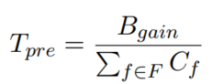
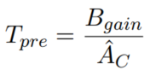
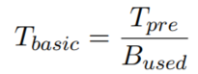
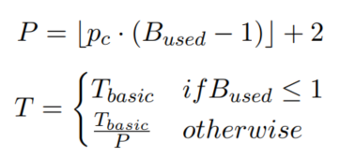
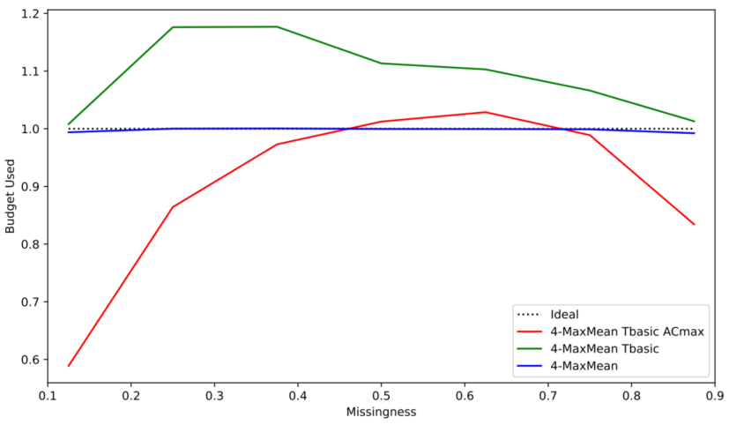
Modelling absolute costs and defining an IPF threshold
Budget becomes available incrementally (B_gain)
budget spent / budget received=1
Set initial threshold by either assuming maximum or average cost
Adjust based on used budget
Add penalty to handle overspending
Notes:
Preferred option using average (estimated number of missing features per instance times average feature costs) Budget becomes incrementally available Curves drop of becaue of maxmean strategy (best feature missing is more likely)

Slide 13
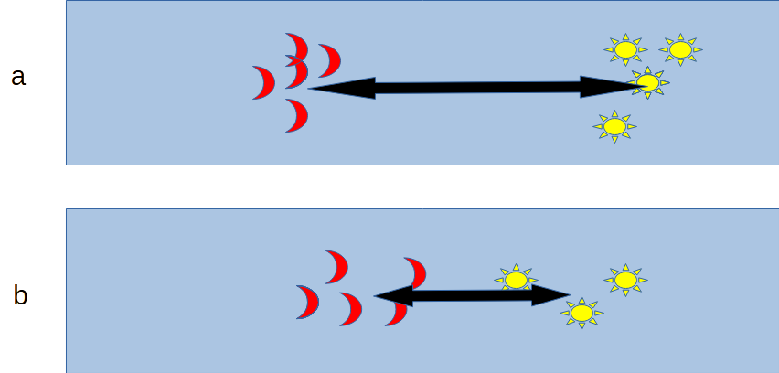
Scoring missing features in a data stream
Mostly relied on Average Euclidean Distance
Use window of past instances to calculate the mean value of each feature given a class
The further apart the higher the importance
Merit = importance / cost
[Yuan, Lanqin, Pfahringer, Bernhard, and Barddal, Jean Paul. “Iterative subset
selection for feature drifting data streams”. In: Proceedings of the 33rd Annual ACM Symposium on Applied Computing, SAC 2018, pp. 510–517. ]
Notes:
Cost are absolute and not normalized

Slide 14
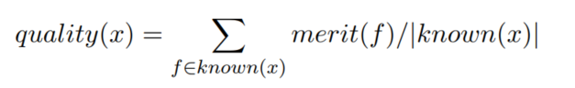
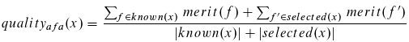
Scoring an instance with missing features in a data stream
Calculate merits of all features
Sum up merits of available features and divide by number of features to get the current instance quality
Calculate quality after acquisition selection
Use the quality (gain) as the score that is presented to the IPF
[4] Beyer, C., Büttner, M., Unnikrishnan, V. et al. Active feature acquisition on data streams under feature drift. Ann. Telecommun. 75, 597–611 (2020)
[5] Büttner, Maik, Beyer, Christian, and Spiliopoulou, Myra. “Reducing Missingness in a Stream through Cost-Aware Active Feature Acquisition”. In: 2022 IEEE 9th International Conference on Data Science and Advanced Analytics (DSAA).
Notes:
Dividing by number of available features is necessary so that we don’t only fill up almost complete instance which would have a high base quality
Quality can not distinguish between an instance that has the best feature missing and second best available and an instance which has the second best available and best missing as resulting quality if we add the best feature would be the same but the quality gain would be different

Slide 15
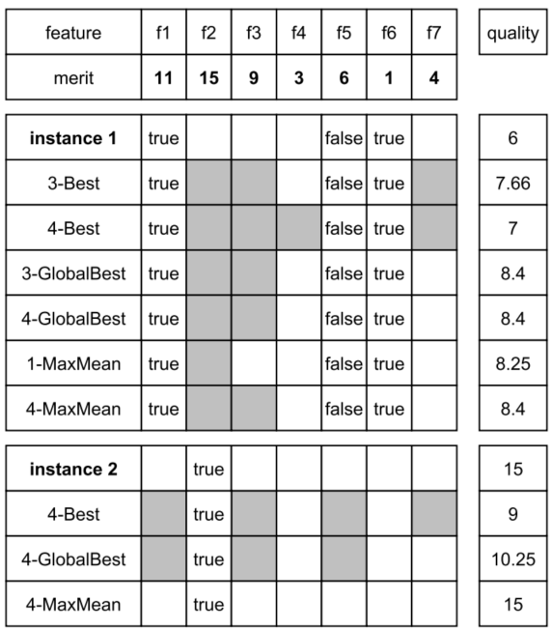
Acquiring multiple features per instance
k-Best missing of the instance
k-GlobalBest irrespective of missing features of the instance
k-MaxMean, adds up to k while quality of instance improves
Notes:
Preferred option using average (Bgain/ (average feature cost * k/2))

Slide 16
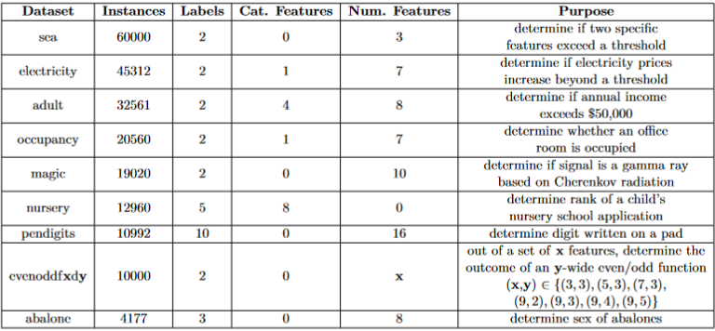
Datasets

Slide 17
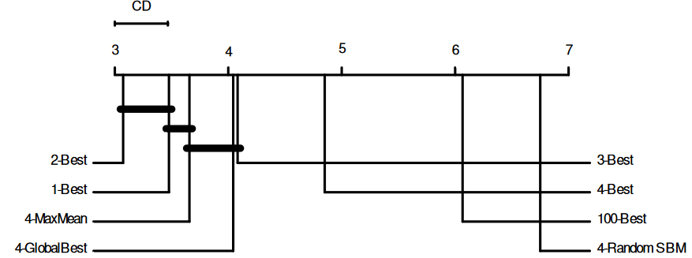
Cost aware AFA vs. random acquisition
Notes:
Occupancy

Slide 18
Conclusion to RQs
RQ3: How can Active Feature Acquisition be realized in a data stream setting? → Combination of feature importance metric, features costs, selection strategies and budget manager (IPF, SBM)
RQ4: How can varying feature costs be considered during AFA on streams? → Model budget gain per instance → Approximate initial threshold based on feature costs → Adjust threshold dynamically using penalty term → Smart use of imputation [6]

Slide 19
Thank you!

Slide 20
References
[1] Beyer, C., Niemann, U., Unnikrishnan, V., Ntoutsi, E. and Spiliopoulou, M., 2018, April. Predicting polarities of entity-centered documents without reading their contents. In Proceedings of the 33rd Annual ACM Symposium on Applied Computing (pp. 525-528).
[2] Beyer, C., Unnikrishnan, V., Niemann, U., Matuszyk, P., Ntoutsi, E., and Spiliopoulou, M., 2019, April. Exploiting entity information for stream classification over a stream of reviews. In Proceedings of the 34th ACM/SIGAPP Symposium on Applied Computing (pp. 564–573) [3] Beyer, C., Unnikrishnan, V., Brüggemann, R. et al. Resource management for model learning at entity level. Ann. Telecommun. 75, 549–561 (2020) [4 Beyer, C., Büttner, M., Unnikrishnan, V. et al. Active feature acquisition on data streams under feature drift. Ann. Telecommun. 75, 597–611 (2020) [5] Büttner, Maik, Beyer, Christian, and Spiliopoulou, Myra. “Reducing Missingness in a Stream through Cost-Aware Active Feature Acquisition”. In: 2022 IEEE 9th International Conference on Data Science and Advanced Analytics (DSAA). [6] Büttner, Maik, Beyer, Christian, and Spiliopoulou, Myra. “Joining Imputation and Active Feature Acquisition for Cost Saving on Data Streams with Missing Features”. In: International Conference on Discovery Science. Springer. 2023, pp. 308–322.

Slide 21
Backup slides

Slide 22

Motivation for active feature acquisitions (AFA)
AFA on streams is new but many scenarios have stream properties
Concept drift can affect feature distributions and their importance
Intelligent budget usage is beneficial for stakeholders
[https://toplabdirect.com/patient-services/blood-work/]

Slide 23
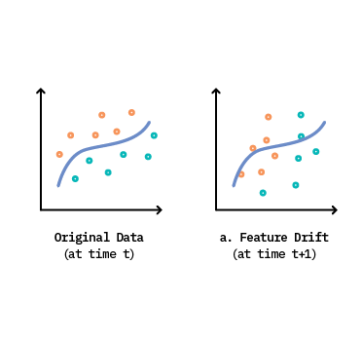
Motivation for active feature acquisitions (AFA)
AFA on streams had not been considered but many scenarios have stream properties
Concept drift can affect feature distributions and their importance
Intelligent budget usage is beneficial for stakeholders
[https://concept-drift.fastforwardlabs.com/]

Slide 24

Motivation for active feature acquisitions (AFA)
AFA on streams had not been considered but many scenarios have stream properties
Concept drift can affect feature distributions and their importance
Intelligent budget usage is beneficial for stakeholders
[https://www.shiksha.com/online-courses/articles/smart-budgeting-approaches-that-you-must-know/]

Slide 25
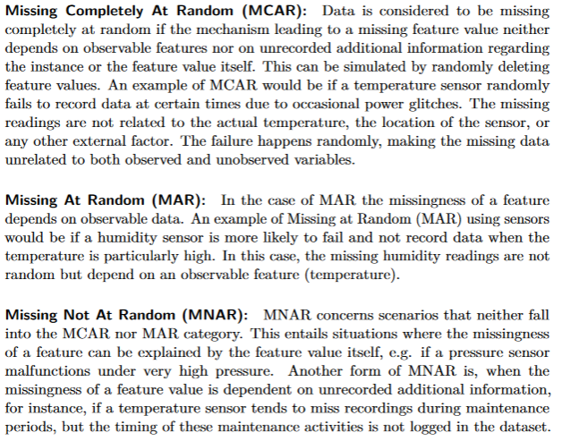
Types of missingness

Slide 26
Budgeting in a static scenario
Static, pool-based active learning requires a scoring function (based on the ML model)
It iteratively acquires missing data and updates the model with the true values until all budget is spent
Budget modelled as real costs or number of instances that can be labeled
[https://www.semanticscholar.org/paper/Active-Learning-Literature-Survey-Settles/818826f356444f3daa3447755bf63f171f39ec47/figure/0]
Notes:
Maybe move to backup

Slide 27
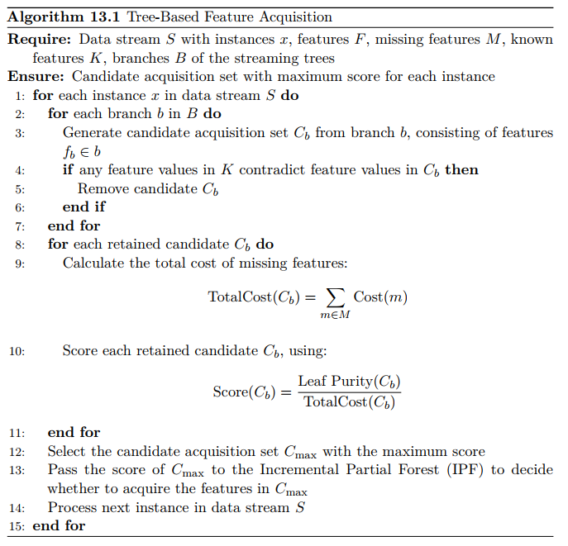
Tree AFA

Slide 28
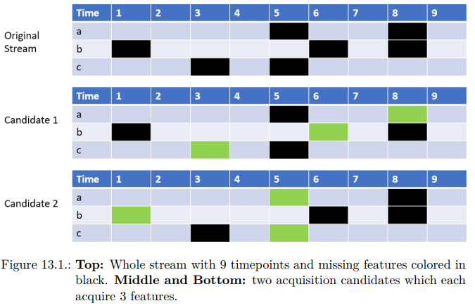
Budget-sensitive baseline with GA

Slide 29
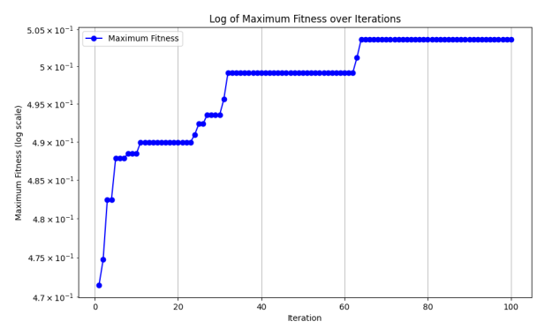
Budget-sensitive baseline with GA

Slide 30
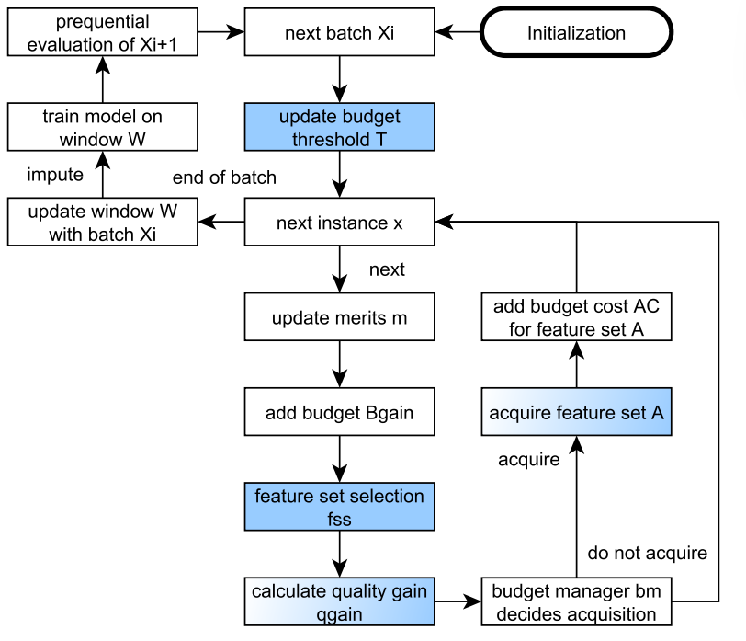
Framework AFA 2
Notes:
Update Threshold after batch so that it doesn’t fluctuate too much but more research needed when would be a good time

Slide 31
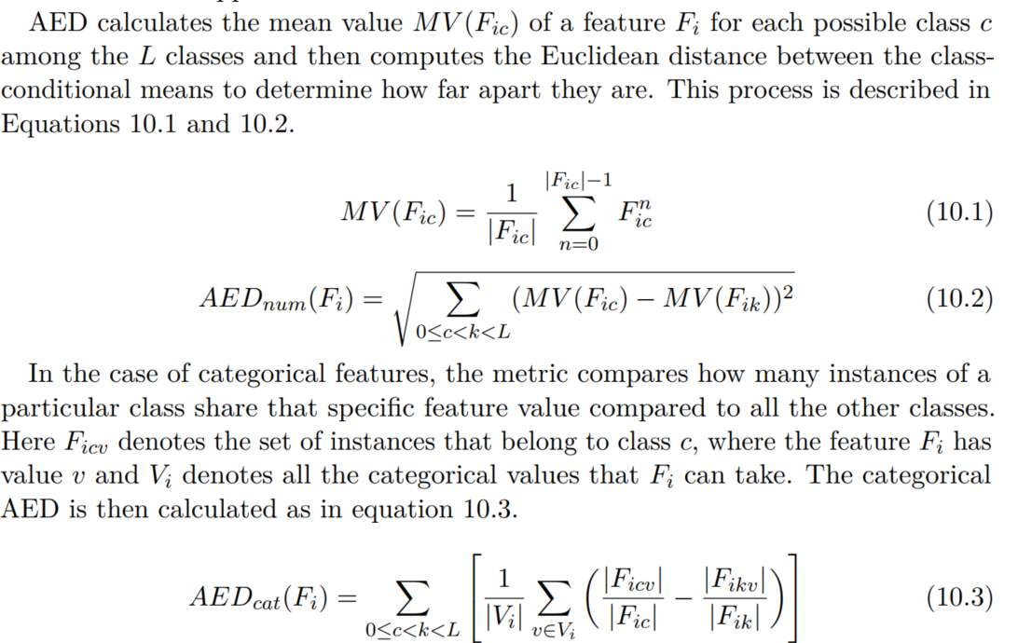
AED

Slide 32
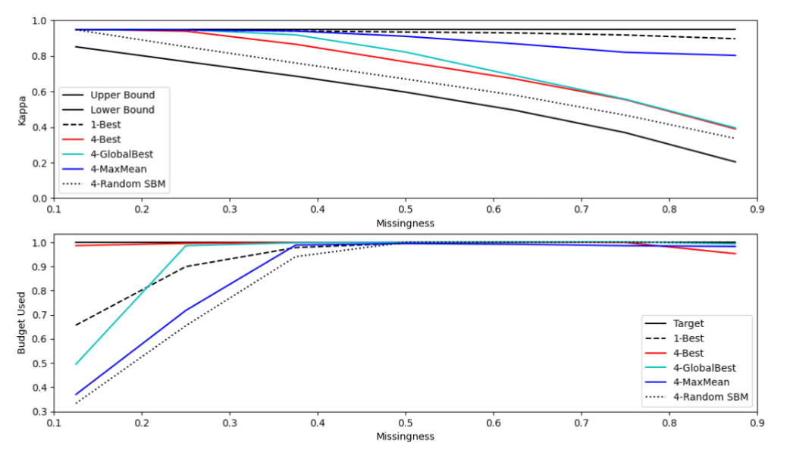
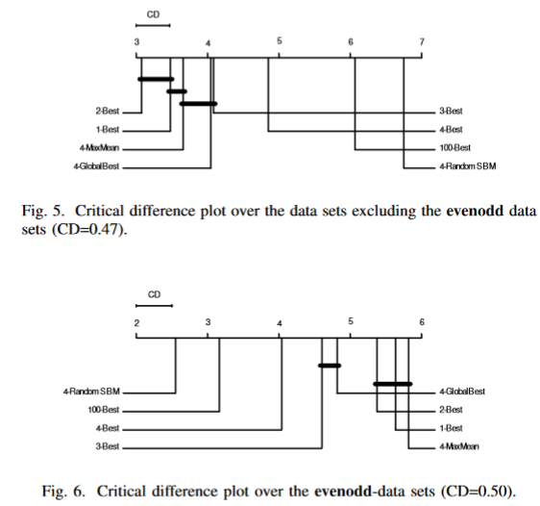
Cost aware AFA vs. random acquisition
Low budget occupancy
Notes:
Occupancy

Slide 33
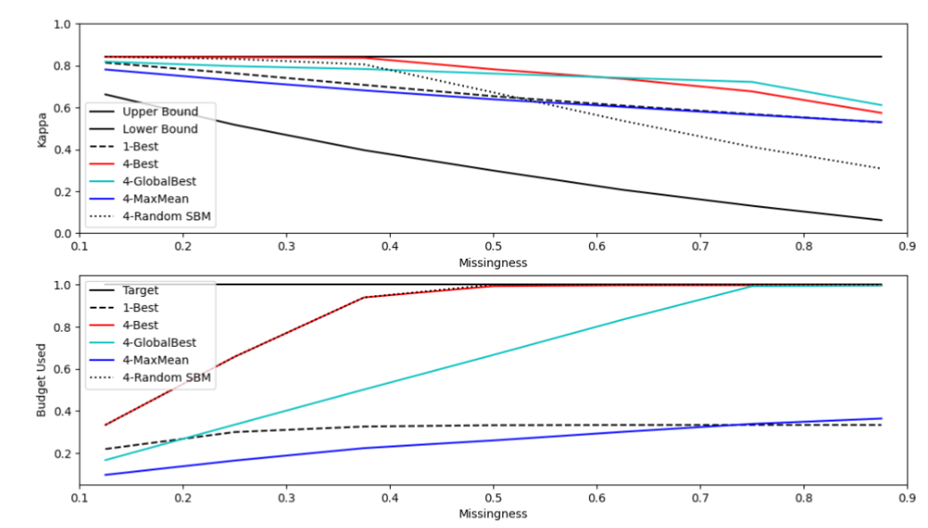
Underspending in high budget nursery dataset

Slide 34
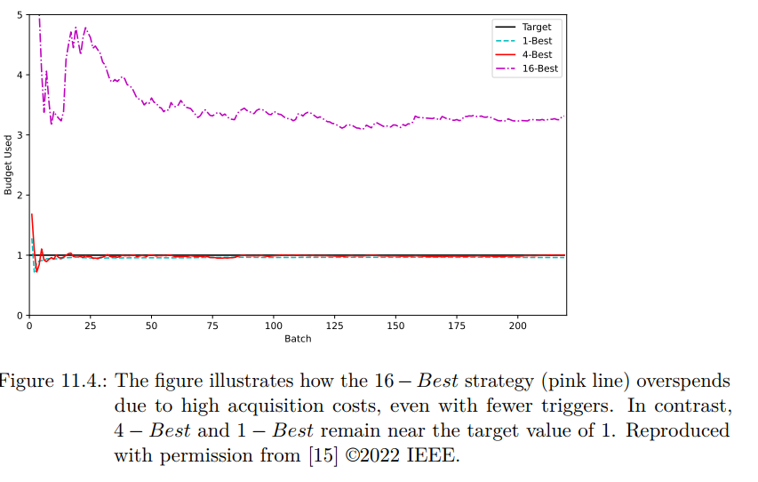
Forced overspending

Slide 35
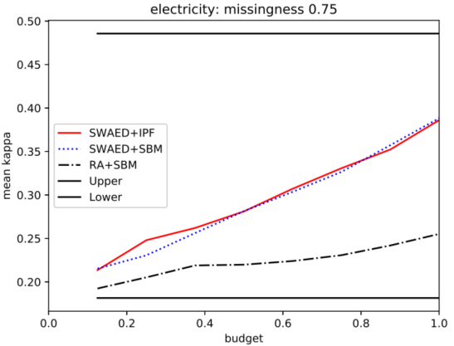
Same cost and one feature per instance
Allows for relative definition of budget e.g. purchase a features for 10% of the instances that have a feature missing
Compared against a random baseline with simple budget management
Adds best missing feature according to merit to an instance and calculates new instance quality
Instance quality is directly handed to the IPF

Slide 36
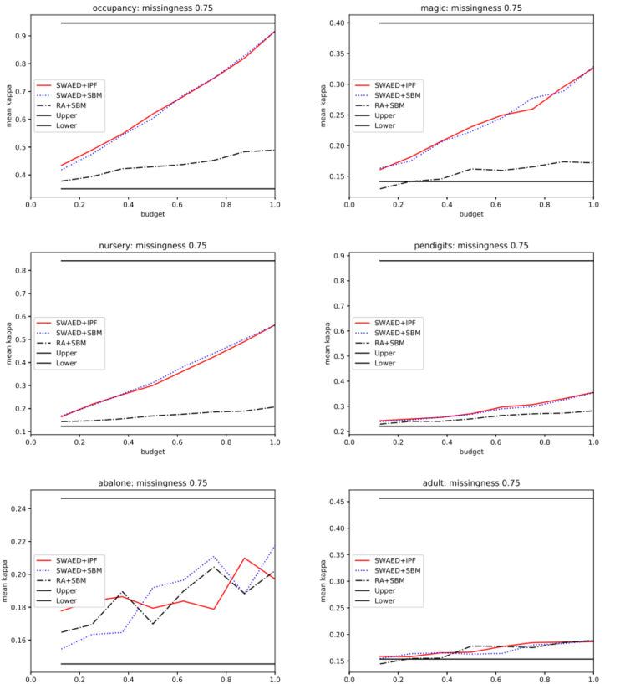
AFA 1 static datasets

Slide 37
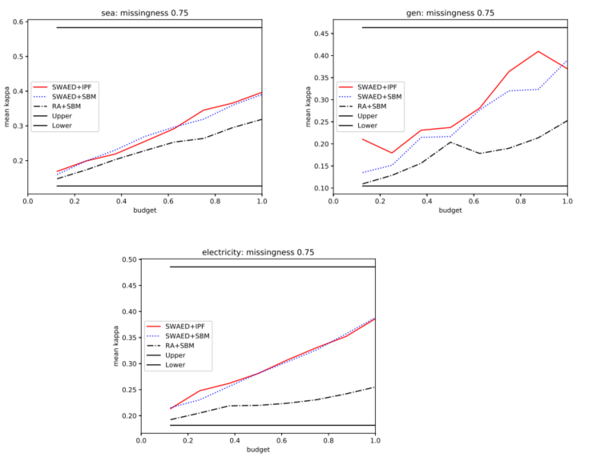
AFA 1 stream datasets

Slide 38
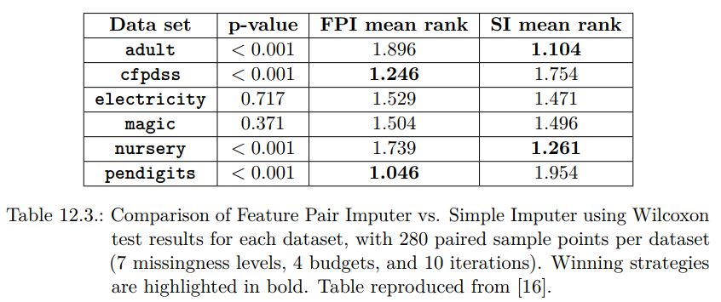
Better imputer needed

Slide 39
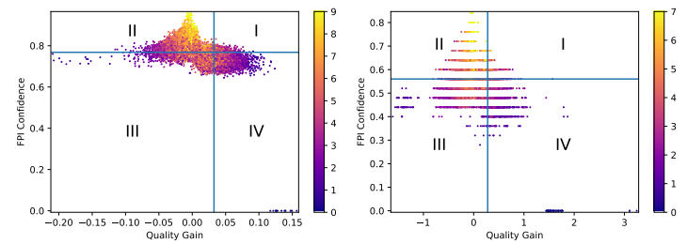
Hybrid approach saving potential

Slide 40
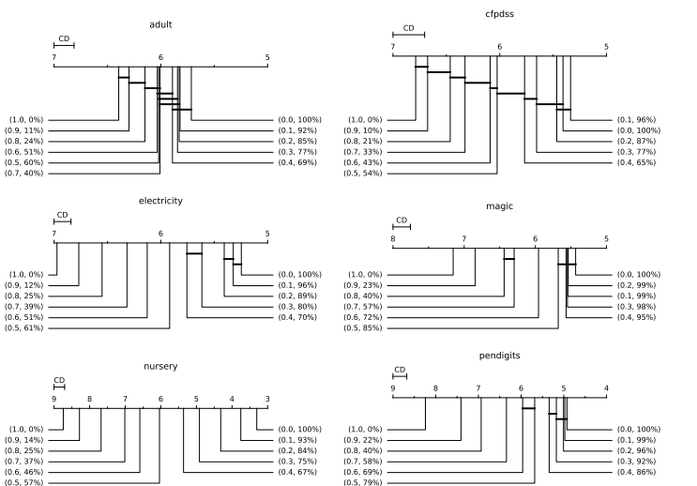
Budget save

Slide 41
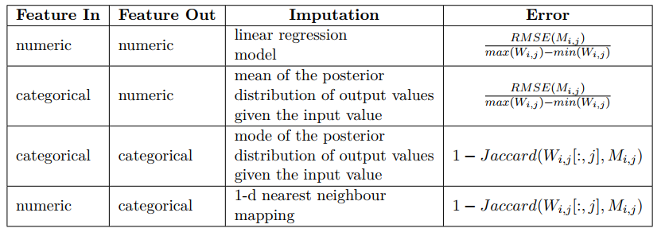
FPI conf 1
Notes:
Max Wi,j is max value in window of features I and J

Slide 42
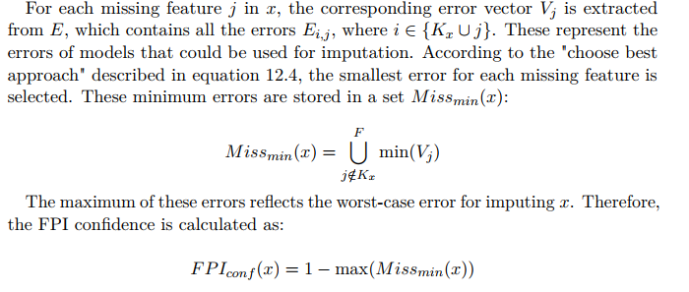
FPI conf selection
Notes:
Select for each missing feature best model(min V_j) to impute and store the error 1-max of these errors (Intuition that imputation as at most as good as worst construction, alternative weighted approach (not implemented)) Here issue is that errors don’t scale the same based on definition but have same range

Slide 43
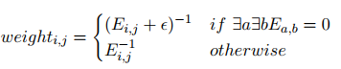
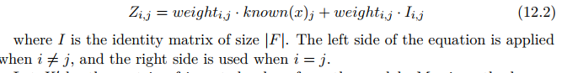
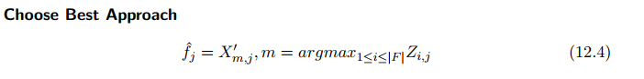
FPI conf imputation
Pick the imputation of model with smallest error (highest weight)
Notes:
Inverse of error as weight so that smaller error gets higher weight Z is weight matrix (left side would be zero if same feature as j is unknown so mask is 0)

Slide 44
Text

Slide 45
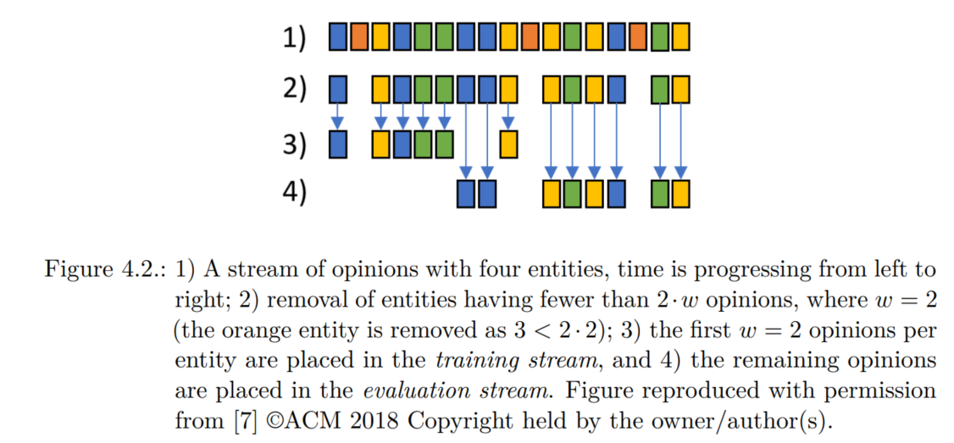
Entity-Centric Eval 1

Slide 46
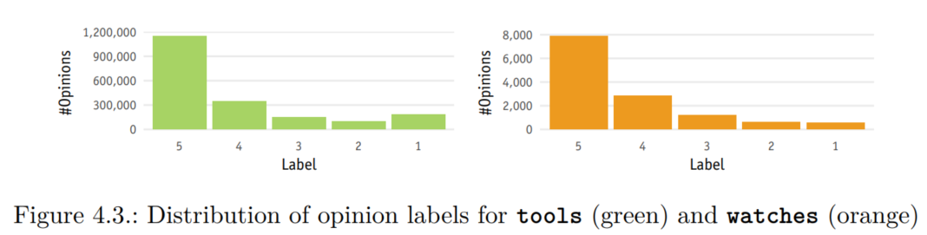
Label distribution of tools and watches

Slide 47
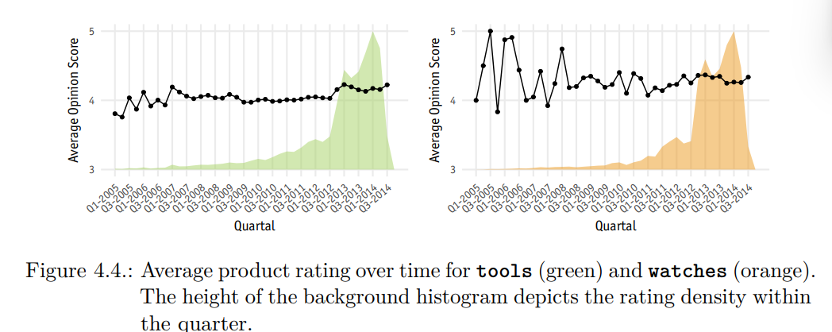
Ent1 ratings over time

Slide 48
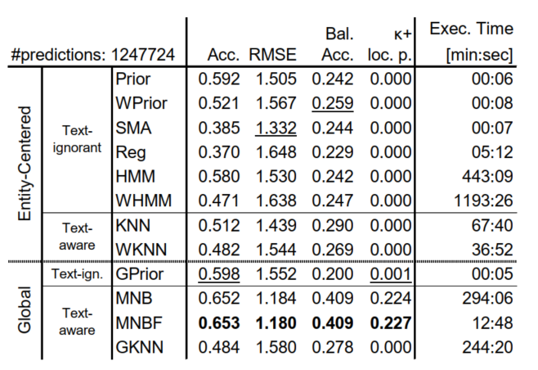
Results ent 1 tools general

Slide 49
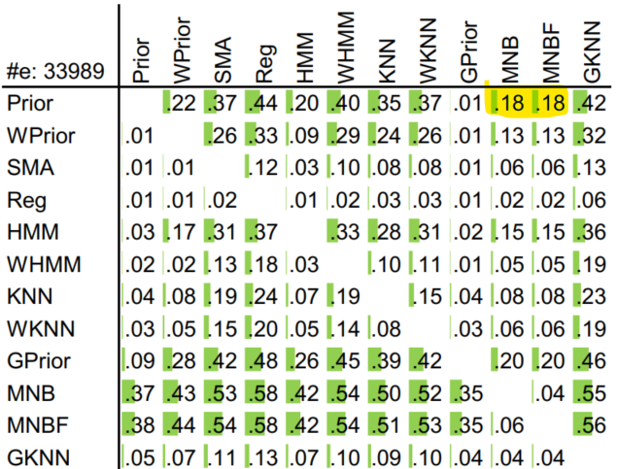
Label-only entity-centric learning results on tools dataset
Compare entity-centric models that only see the labels of the reviews vs. entity-ignorant MNBF which uses the review text
For each product (entity) use w=5 instances to induce model and then test on remaining instances (at least w)
Products with less than 2*w instances get removed
Notes:
Kann wahrscheinlich raus da zu wenig Zeit

Slide 50
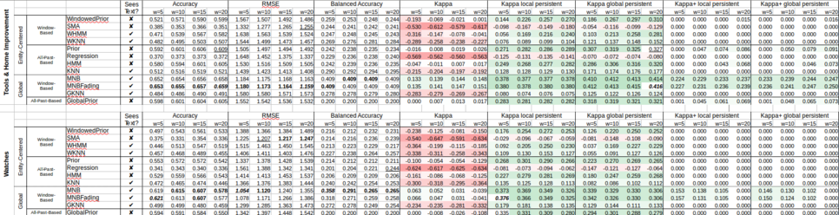
Text

Slide 51
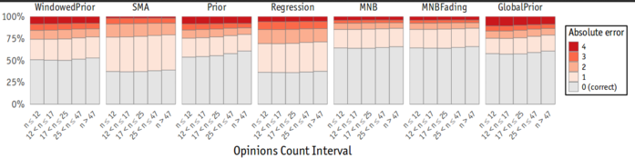
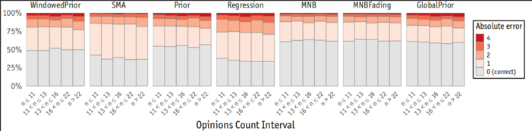
Label-only vs. MNB (top tools, bottom watches)

Slide 52
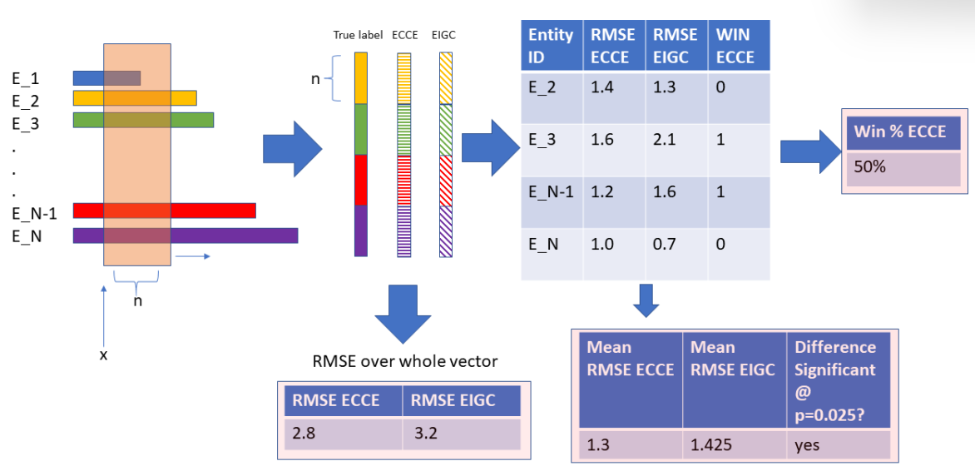
Ent2 framework

Slide 53
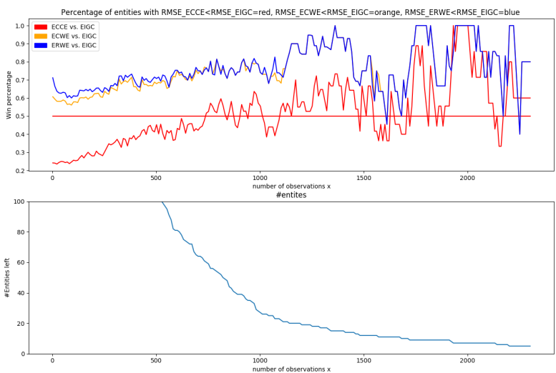
Performance given x training instances

Slide 54
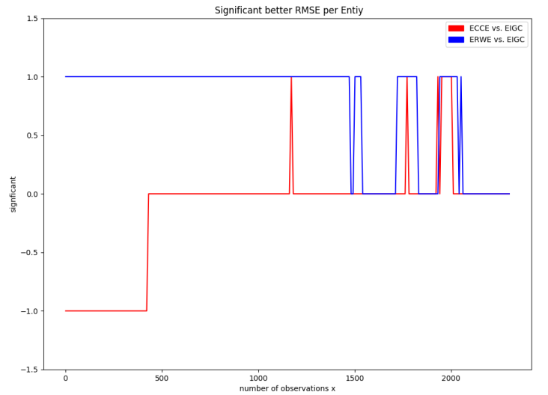
Entity-based significance test

Slide 55
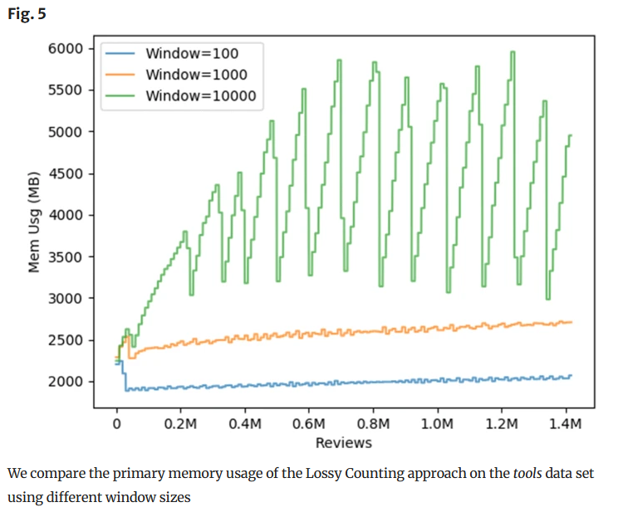
Different parameters for lossy counting
The memory requirements of the lossy counting method depend on how the parameter 𝜖 is set, as it affects the window size of the lossy counting buckets. In our experiments, we used an 𝜖 of 0.001 which equals a window size of 1000.
The lossy counting algorithm stores models on the disk if they do not appear once per window on average.
We can ignore the user parameter s as we are not interested in reporting frequent item sets or frequent entities.

Slide 56
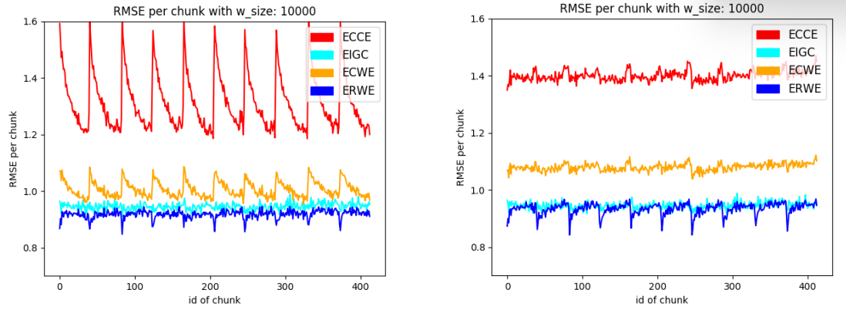
Yelp results
Notes:
Spikes because of new entities arriving where fresh MNBF sucks

Slide 57
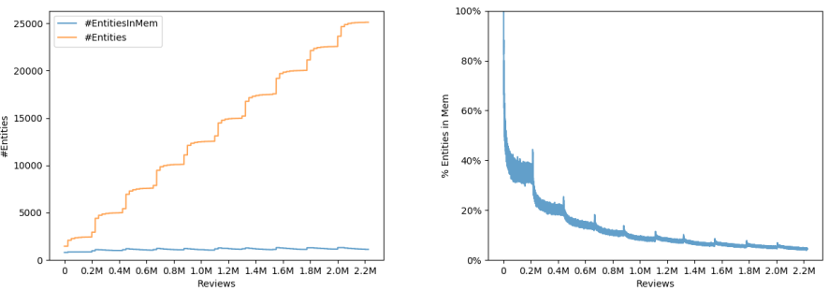
Yelp entities in memory

Slide 58
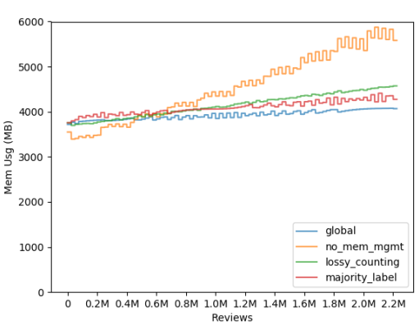
Yelp results memory

Slide 59

Ensemble errors

